Slide 1
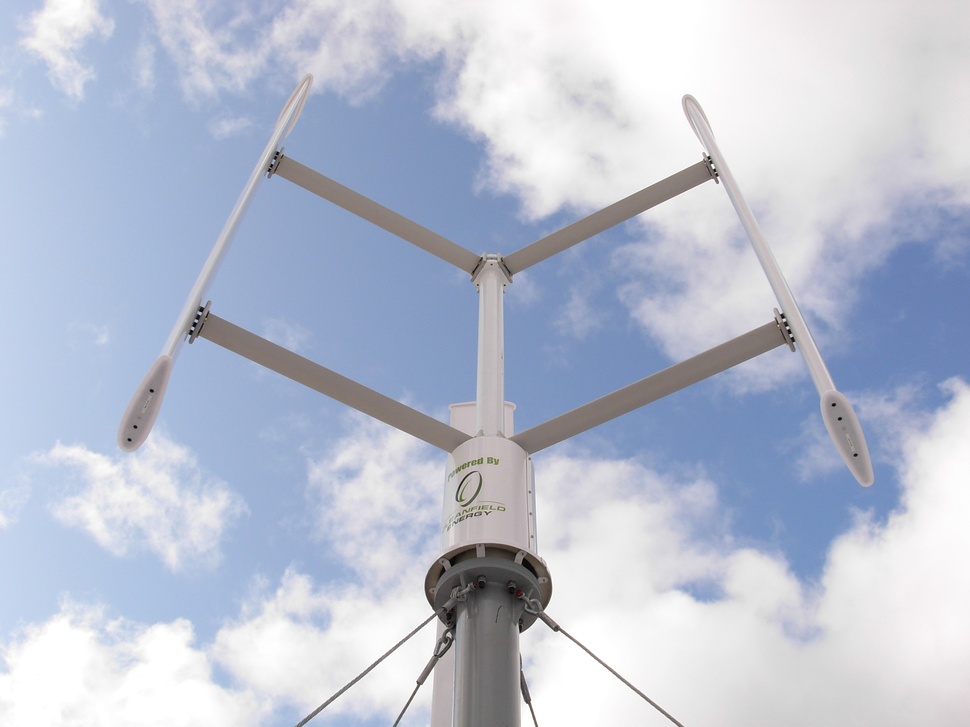
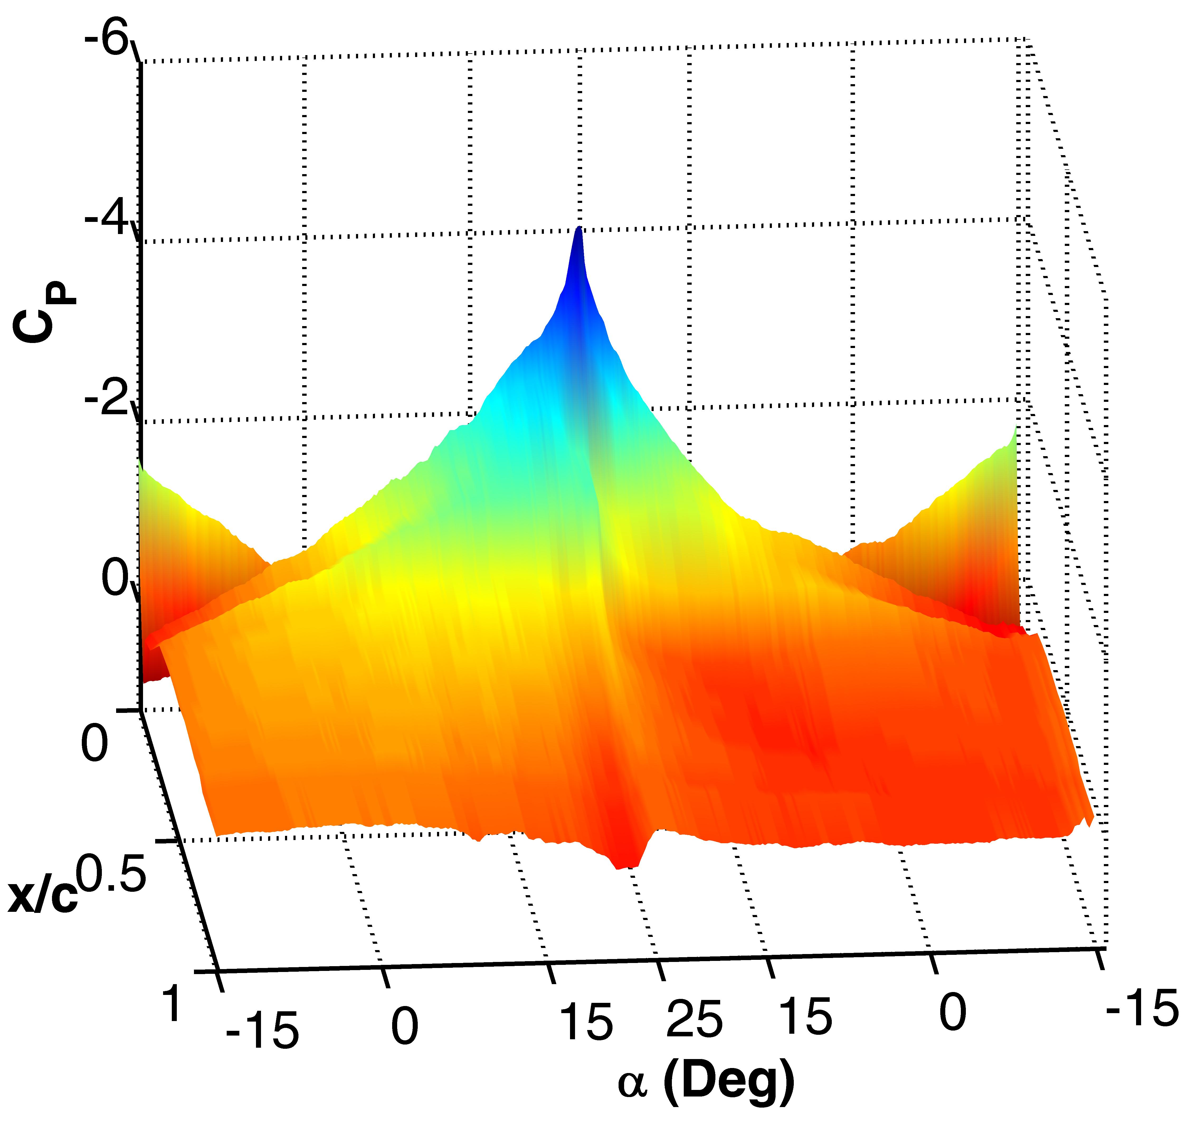
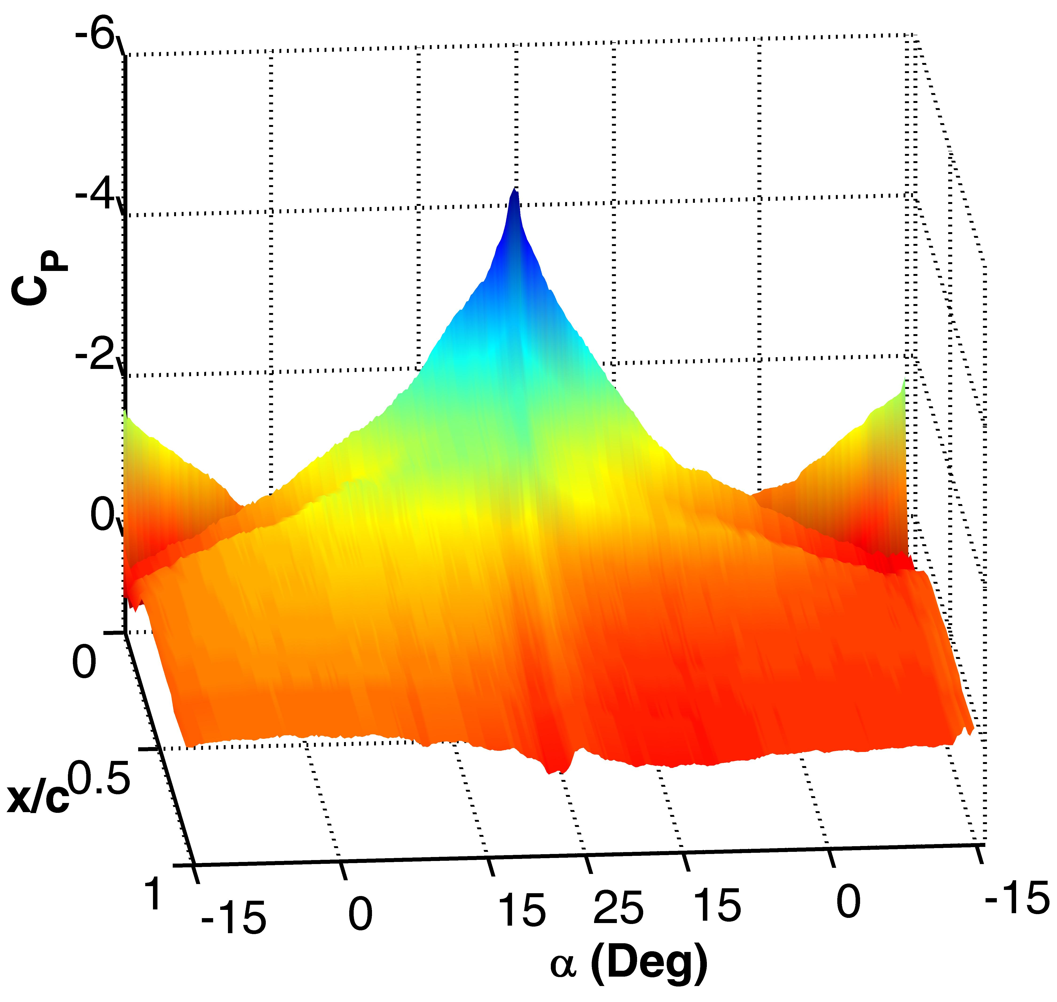
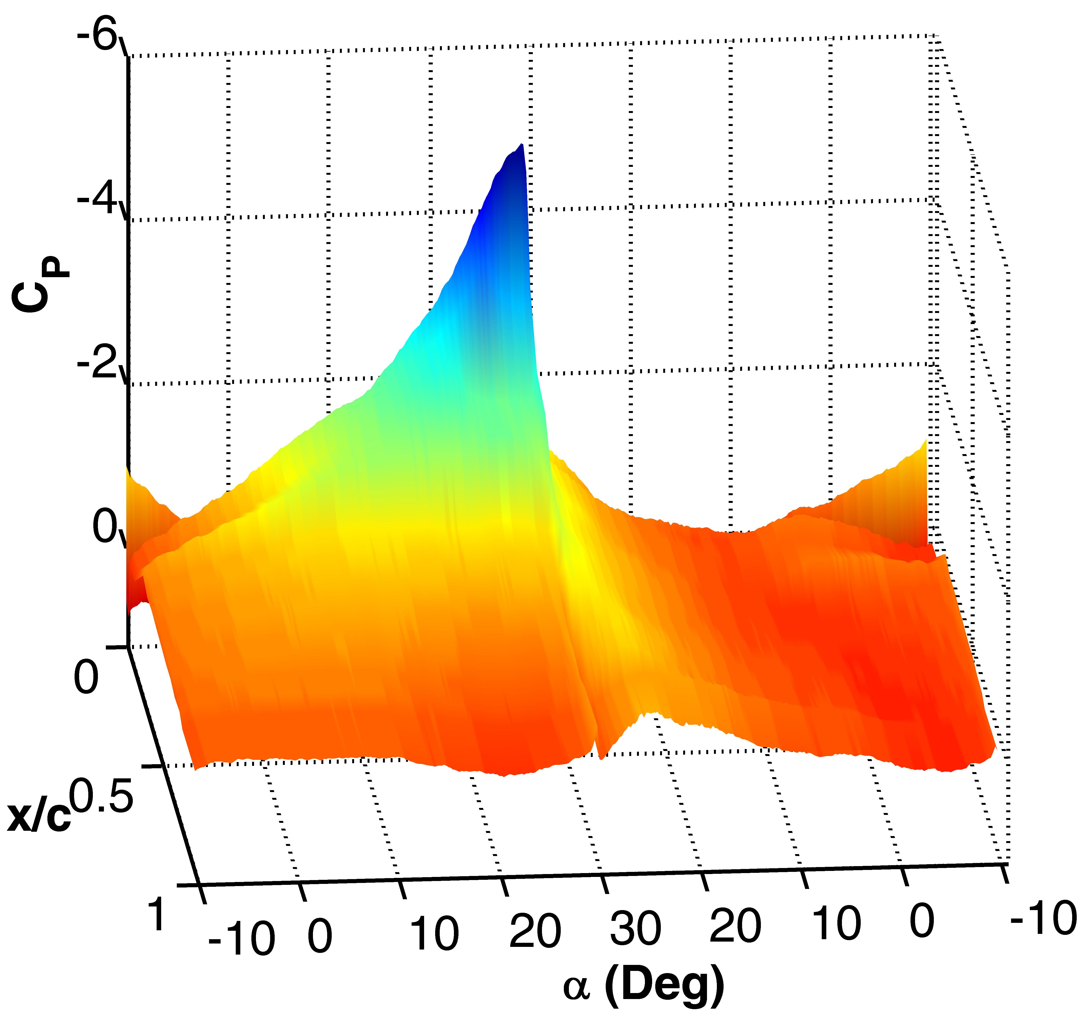
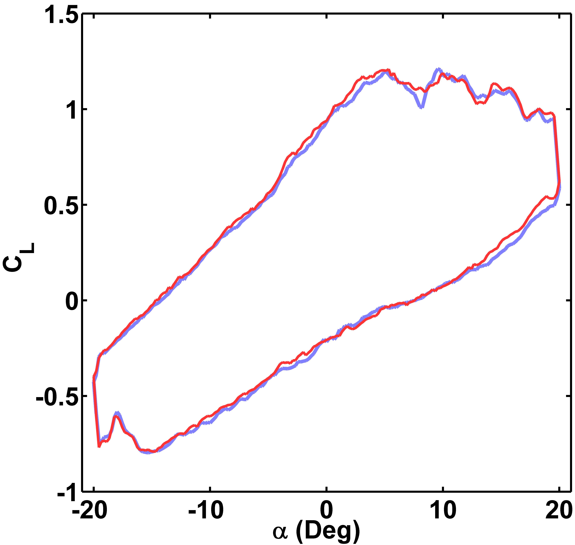
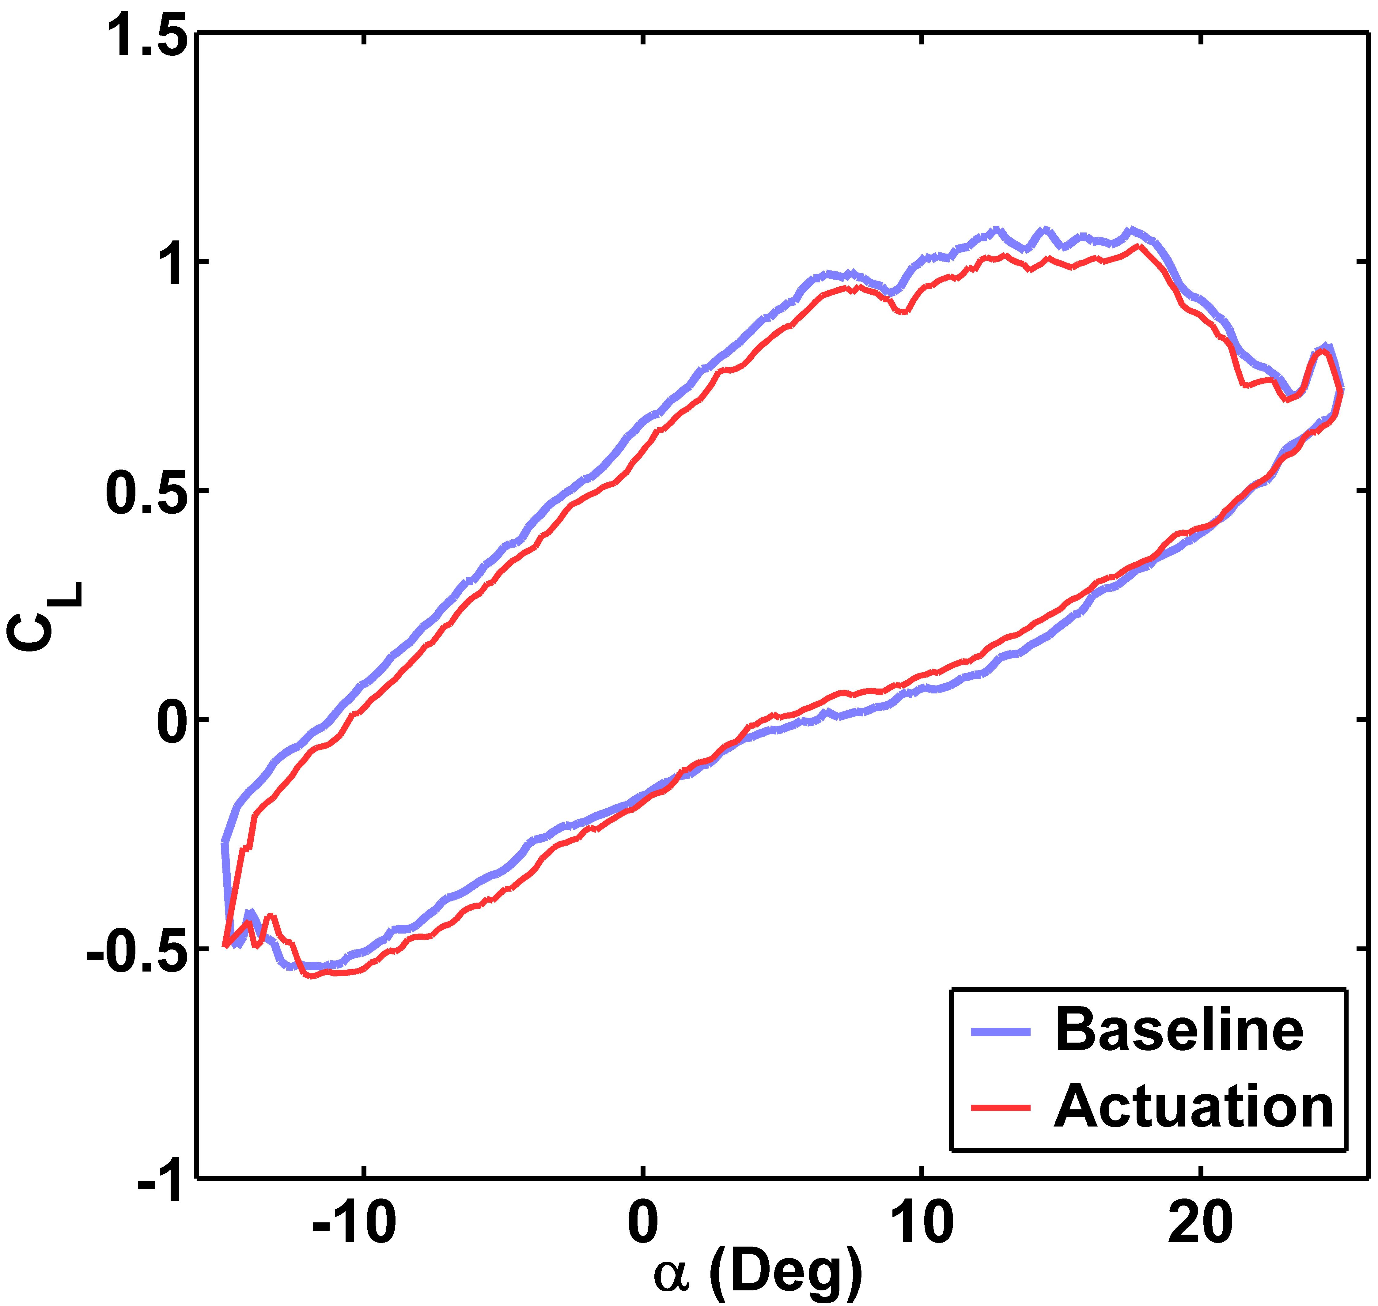
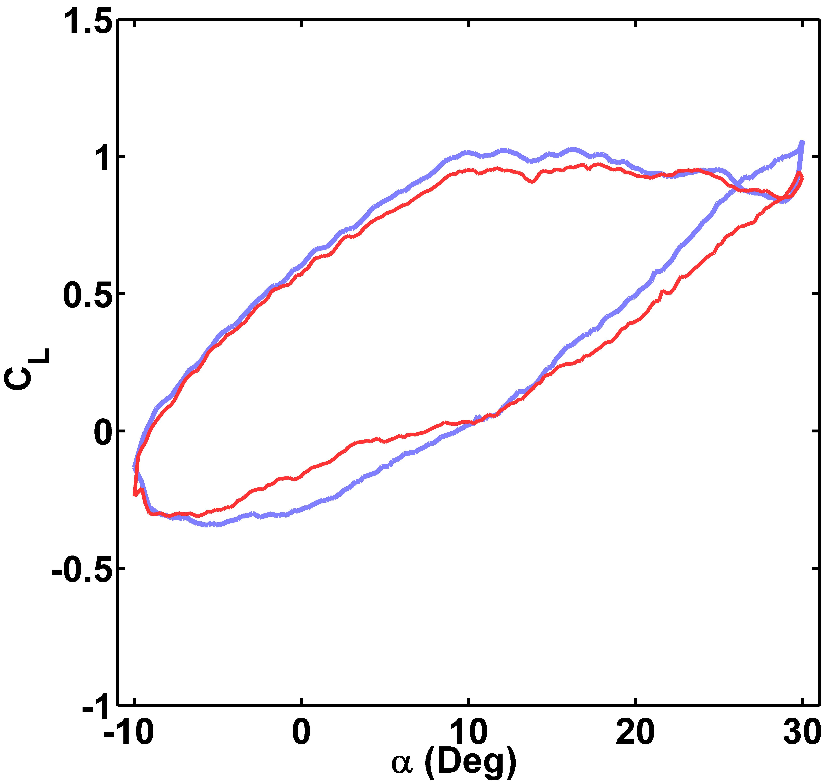
Engineering
Taste of Research Summer Scholarship Program
Title: Arial font, bold, 82pt
Author: Arial font, italic, 72pt
Supervisor: Arial font, italic, 48pt
Red Box represents bleed lines. Delete Red Box once poster is complete, prior to submission.
Heading: Arial font, bold, 36pt
Images/graphs appearing on this template are placeholders only. Number and position of images/graphs can be customised.
Body text: Arial font, 24pt
Heading: Arial font, bold, 36pt
Heading: Arial font, bold, 36pt
Paragraph and character styles have been set as indicated. Please do not change formatting. However, size and position of boxes can be modified to fit text.
Body text: Arial font, 24pt
Body text: Arial font, 24pt
Heading: Arial font, bold, 36pt
Sub-heading: Arial font, italic 30pt
Body text: Arial font, 24pt
Heading: Arial font, bold, 36pt
Body text: Arial font, 24pt

